Slide 1

COMPUTER NETWORKING
LAB 5

Slide 2
FTP

Slide 3
OBJECTIVES
Establishment of the FTP service.
Configuration of FTP server parameters.
Successful file transfer from an FTP server.

Slide 4
FTP
FTP server
At its core, the file transfer protocol is a way to connect two computers to one another in the safest possible way to help transfer files between two or more points.
FTP servers can be considered the midpoint between the sender and the recipient of a file.

Slide 5
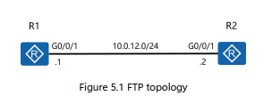
Topology

Slide 6
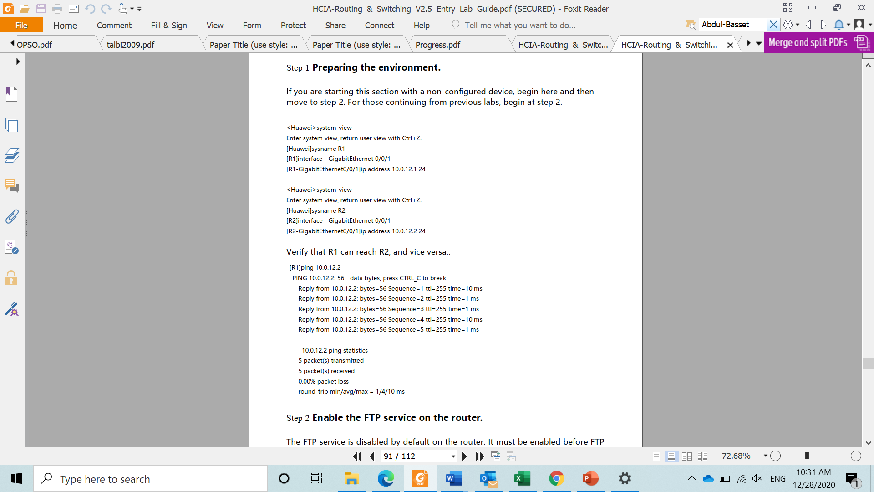
Prepare the environment
Establish the basic system configuration and addressing for the lab

Slide 7
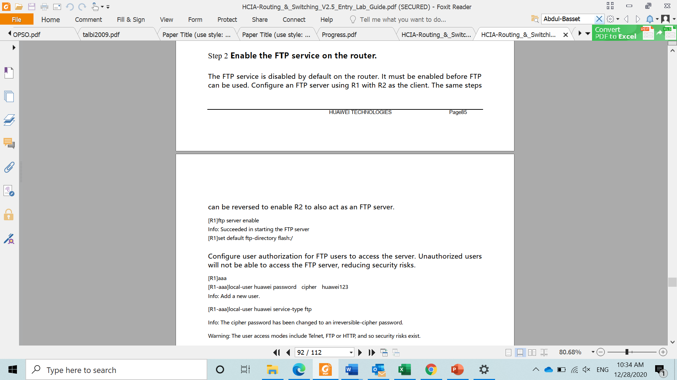
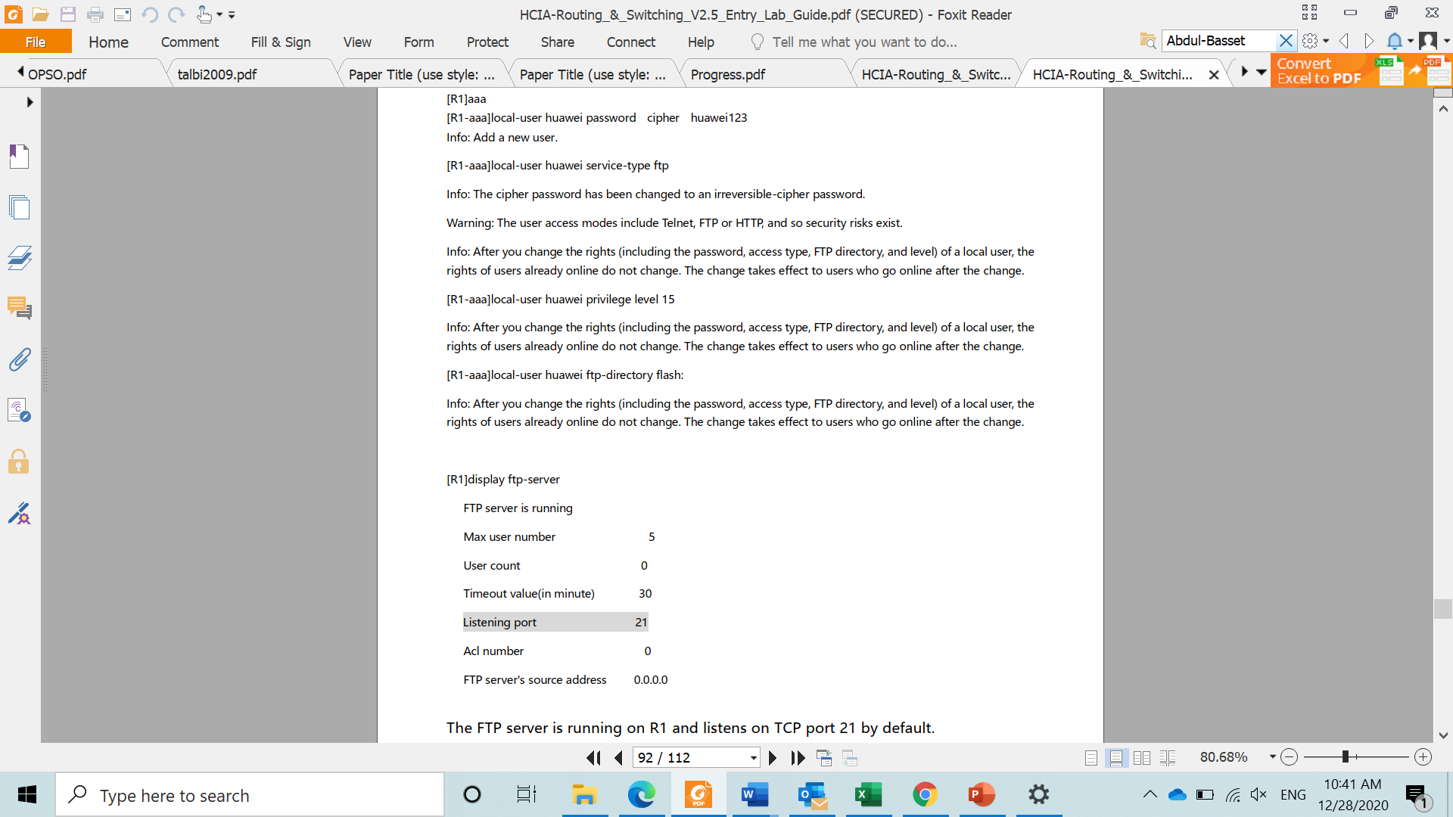
Enable the FTP service on the router
The FTP service is disabled by default on the router.
It must be enabled before FTP can be used.
Configure an FTP server using R1 with R2 as the client.
Configure user authorization for FTP users to access the server. Unauthorized users will not be able to access the FTP server, reducing security risks.

Slide 8
FTP server configuration
The FTP server is running on R1 and listens on TCP port 21 by default.

Slide 9
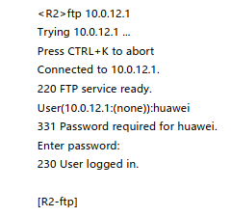
Establish an FTP client connection
Establish a connection to the FTP server from R2
Following entry of the correct username and password, the FTP server can be successfully logged into

Slide 10
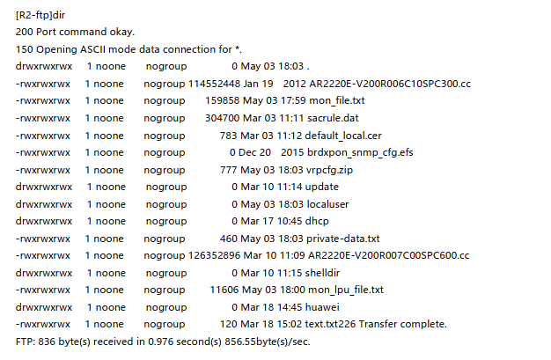
Establish an FTP client connection
Run the dir command before downloading a file or or after uploading a file to view the detailed information of the file.

Slide 11
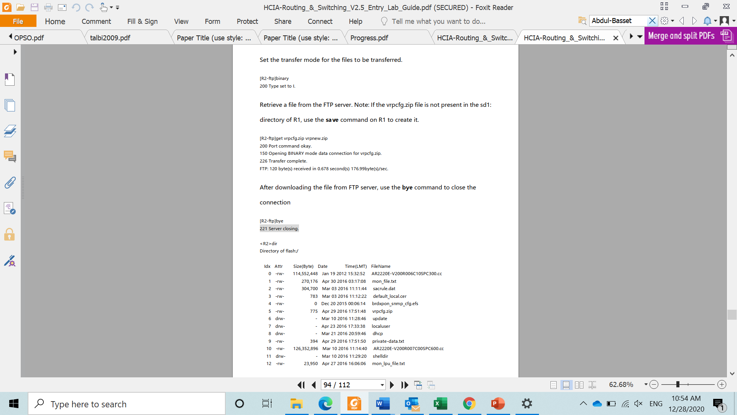
Establish an FTP client connection
Set the transfer mode for the files to be transferred.
Retrieve a file from the FTP server.
NOTE: if the vrpcfg.zip.file is not present in the sd1: directory of R1, use the save command on R1 to create it.
After downloading the file from FTP server use the bye command to close the connection

Slide 12
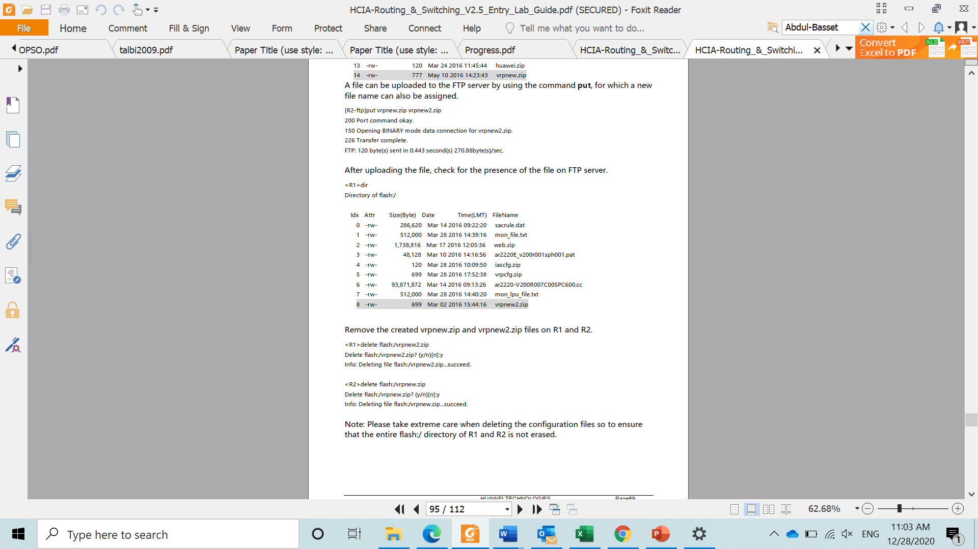
Establish an FTP client connection

Slide 13
Establish an FTP client connection
A file can be uploaded to the FTP server by using the command put, for which a new file name can also be assigned.
After uploading the file, check for the presence of the file on FTP server.

Slide 14
Establish an FTP client connection
Remove the created vrpnew2.zip files on R1 and R2.
NOTE: take extreme care when deleting the configuration files so to ensure that the entire flash:/ directory of R1 and R2 is not erased

Slide 15
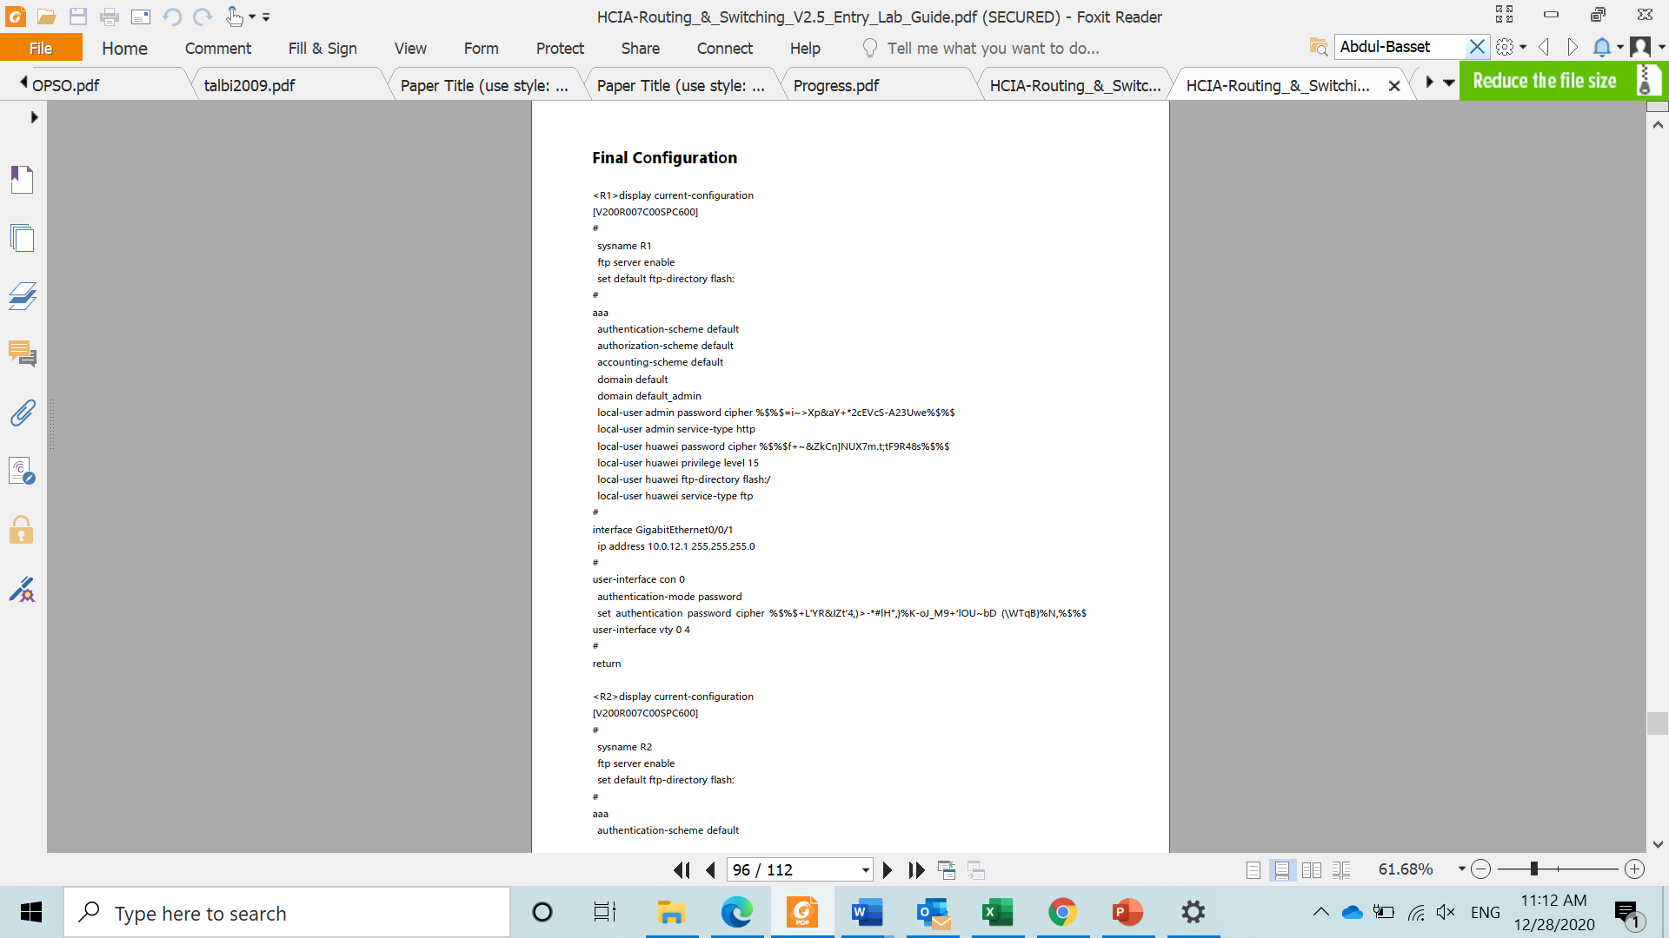
Final configuration

Slide 16
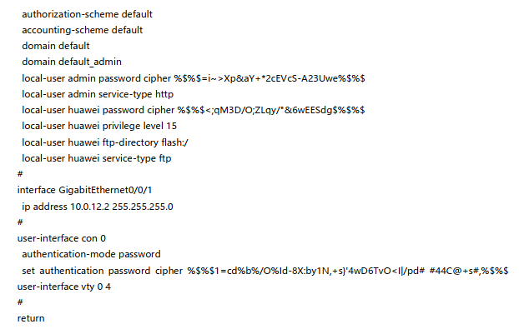
Final configuration

Slide 17
FileZilla Client,
FTP Voyager,
WinSCP,
Coffee Cup Free FTP,
Core FTP.

